Slide 1
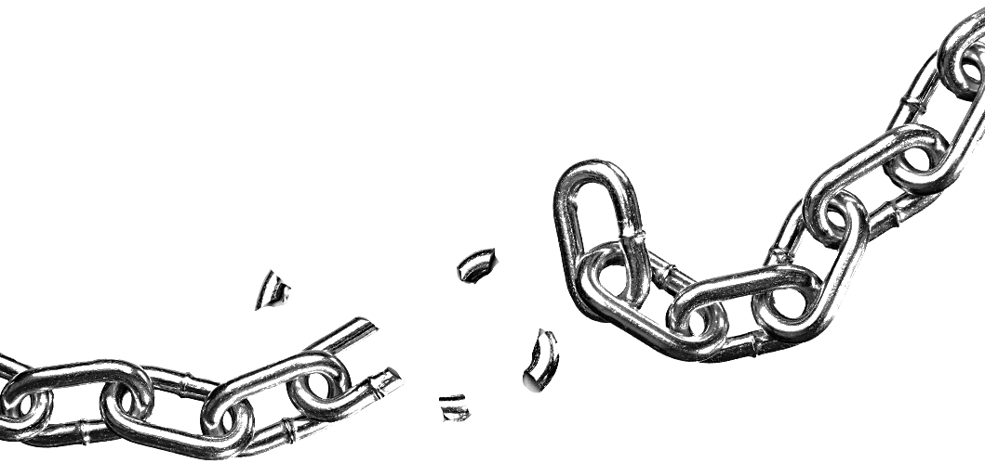
Breaking The Cyber Kill Chain Using CDR
(content disarm and reconstruction)

Slide 2

Panji Iman Baskoro
171111023
panjidia995@gmail.com
panjibaskoro.web.id

Slide 3
The Cyber Kill Chain
it’s not as simple a method. it’s talk about a phase

Slide 4

The Origin of
Cyber Kill Chain
Originally named Kill Chain in military field

Slide 5
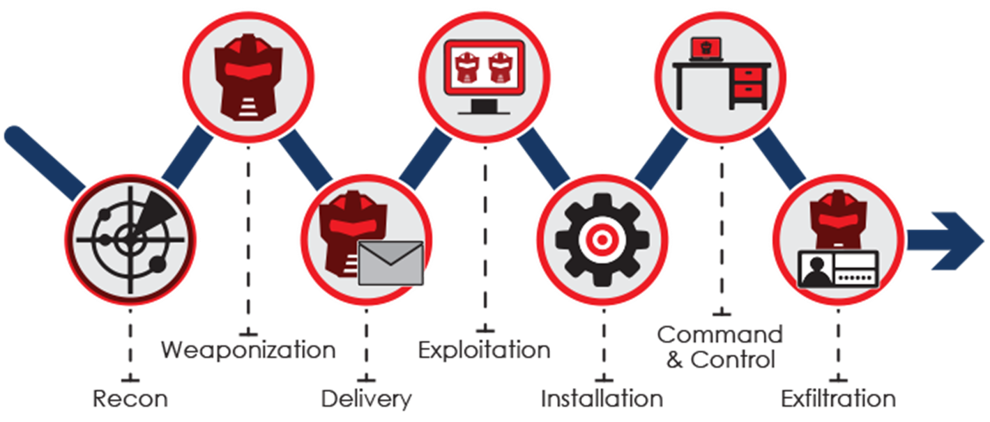
The Cyber Kill Chain : phases

Slide 6
Cyber Kill Chain tidak hanya memudahkan penyerang, untuk melakukan aksinya. Tetapi juga membantu kita untuk mengantisipasinya.

Slide 7
How To Break it?

Slide 8

Just Break one of it’s chain

Slide 9
Breaking Delivery phase Cyber Kill Chain

Slide 10
Introducing Content Disarm and Reconstruction

Slide 11
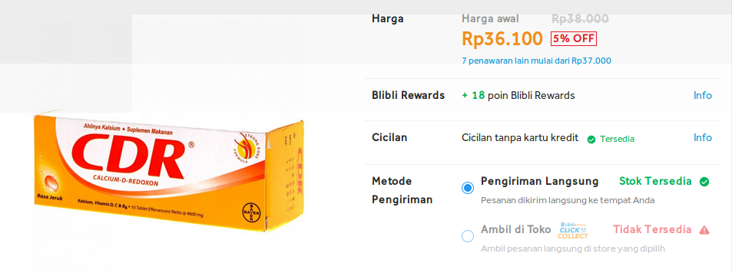
Bukan yang ini!!

Slide 12
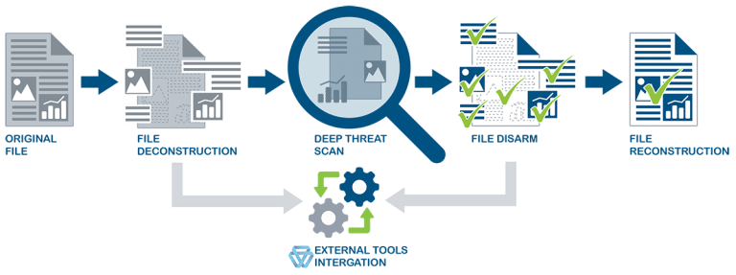
CDR in a nutt shell

Slide 13
CDR in Action
Tools that used in this action is fully open-sources and available on github

